Slide 1

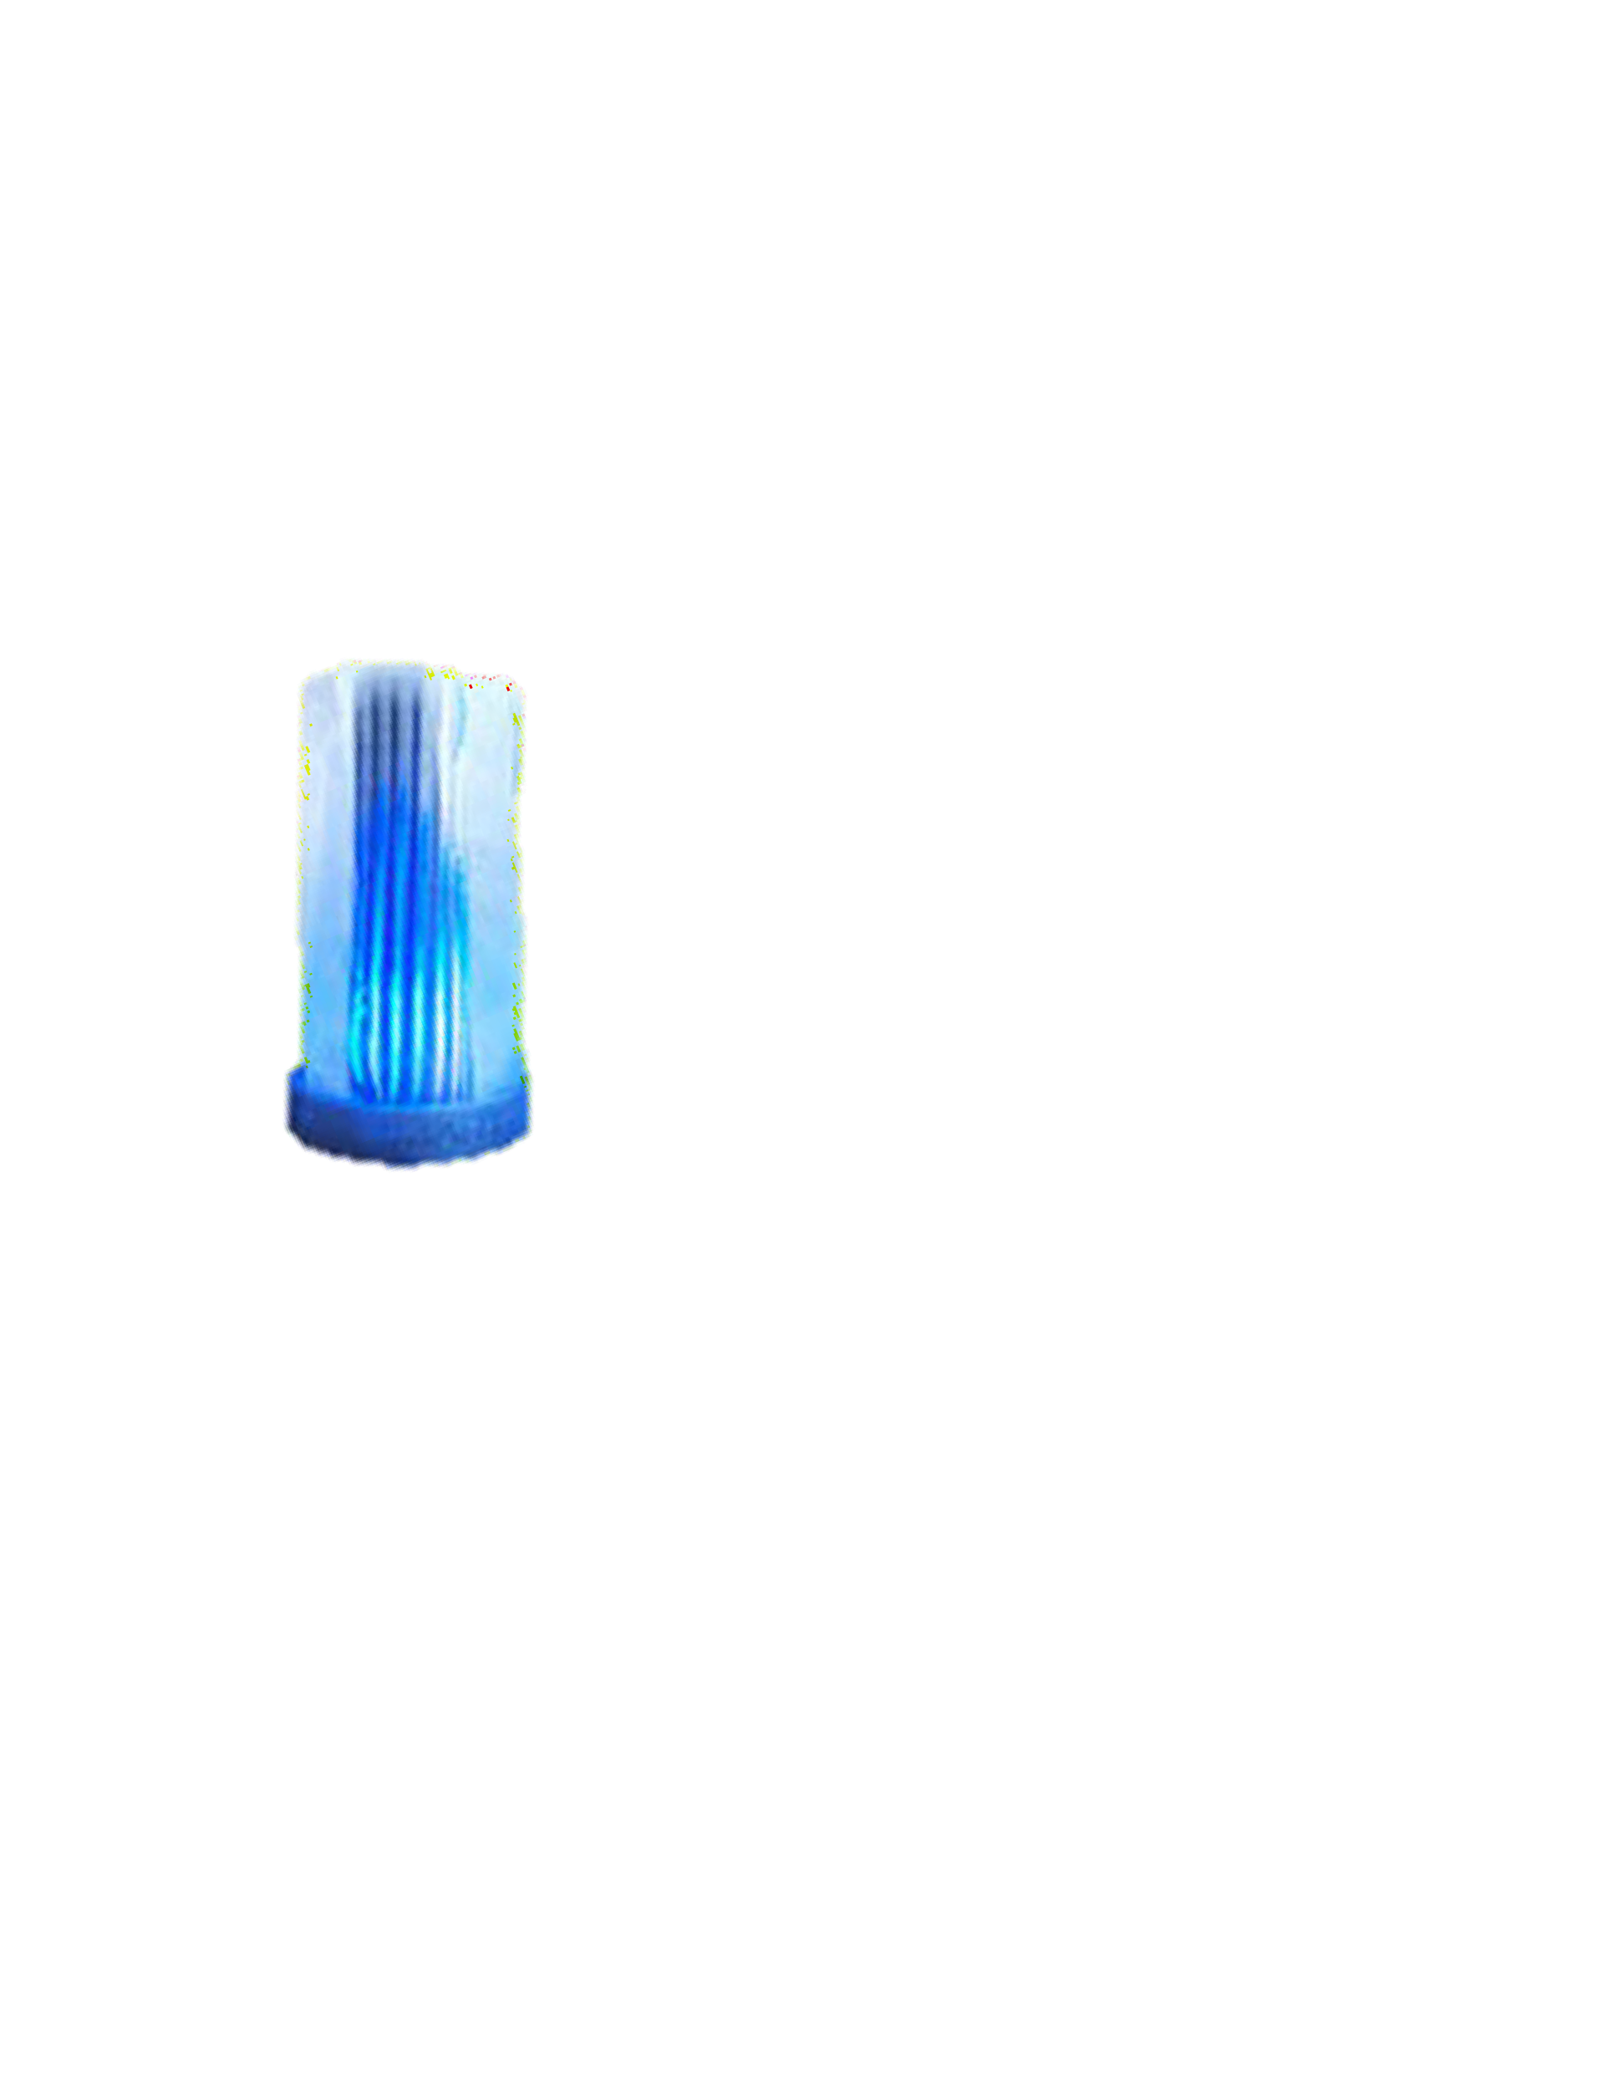
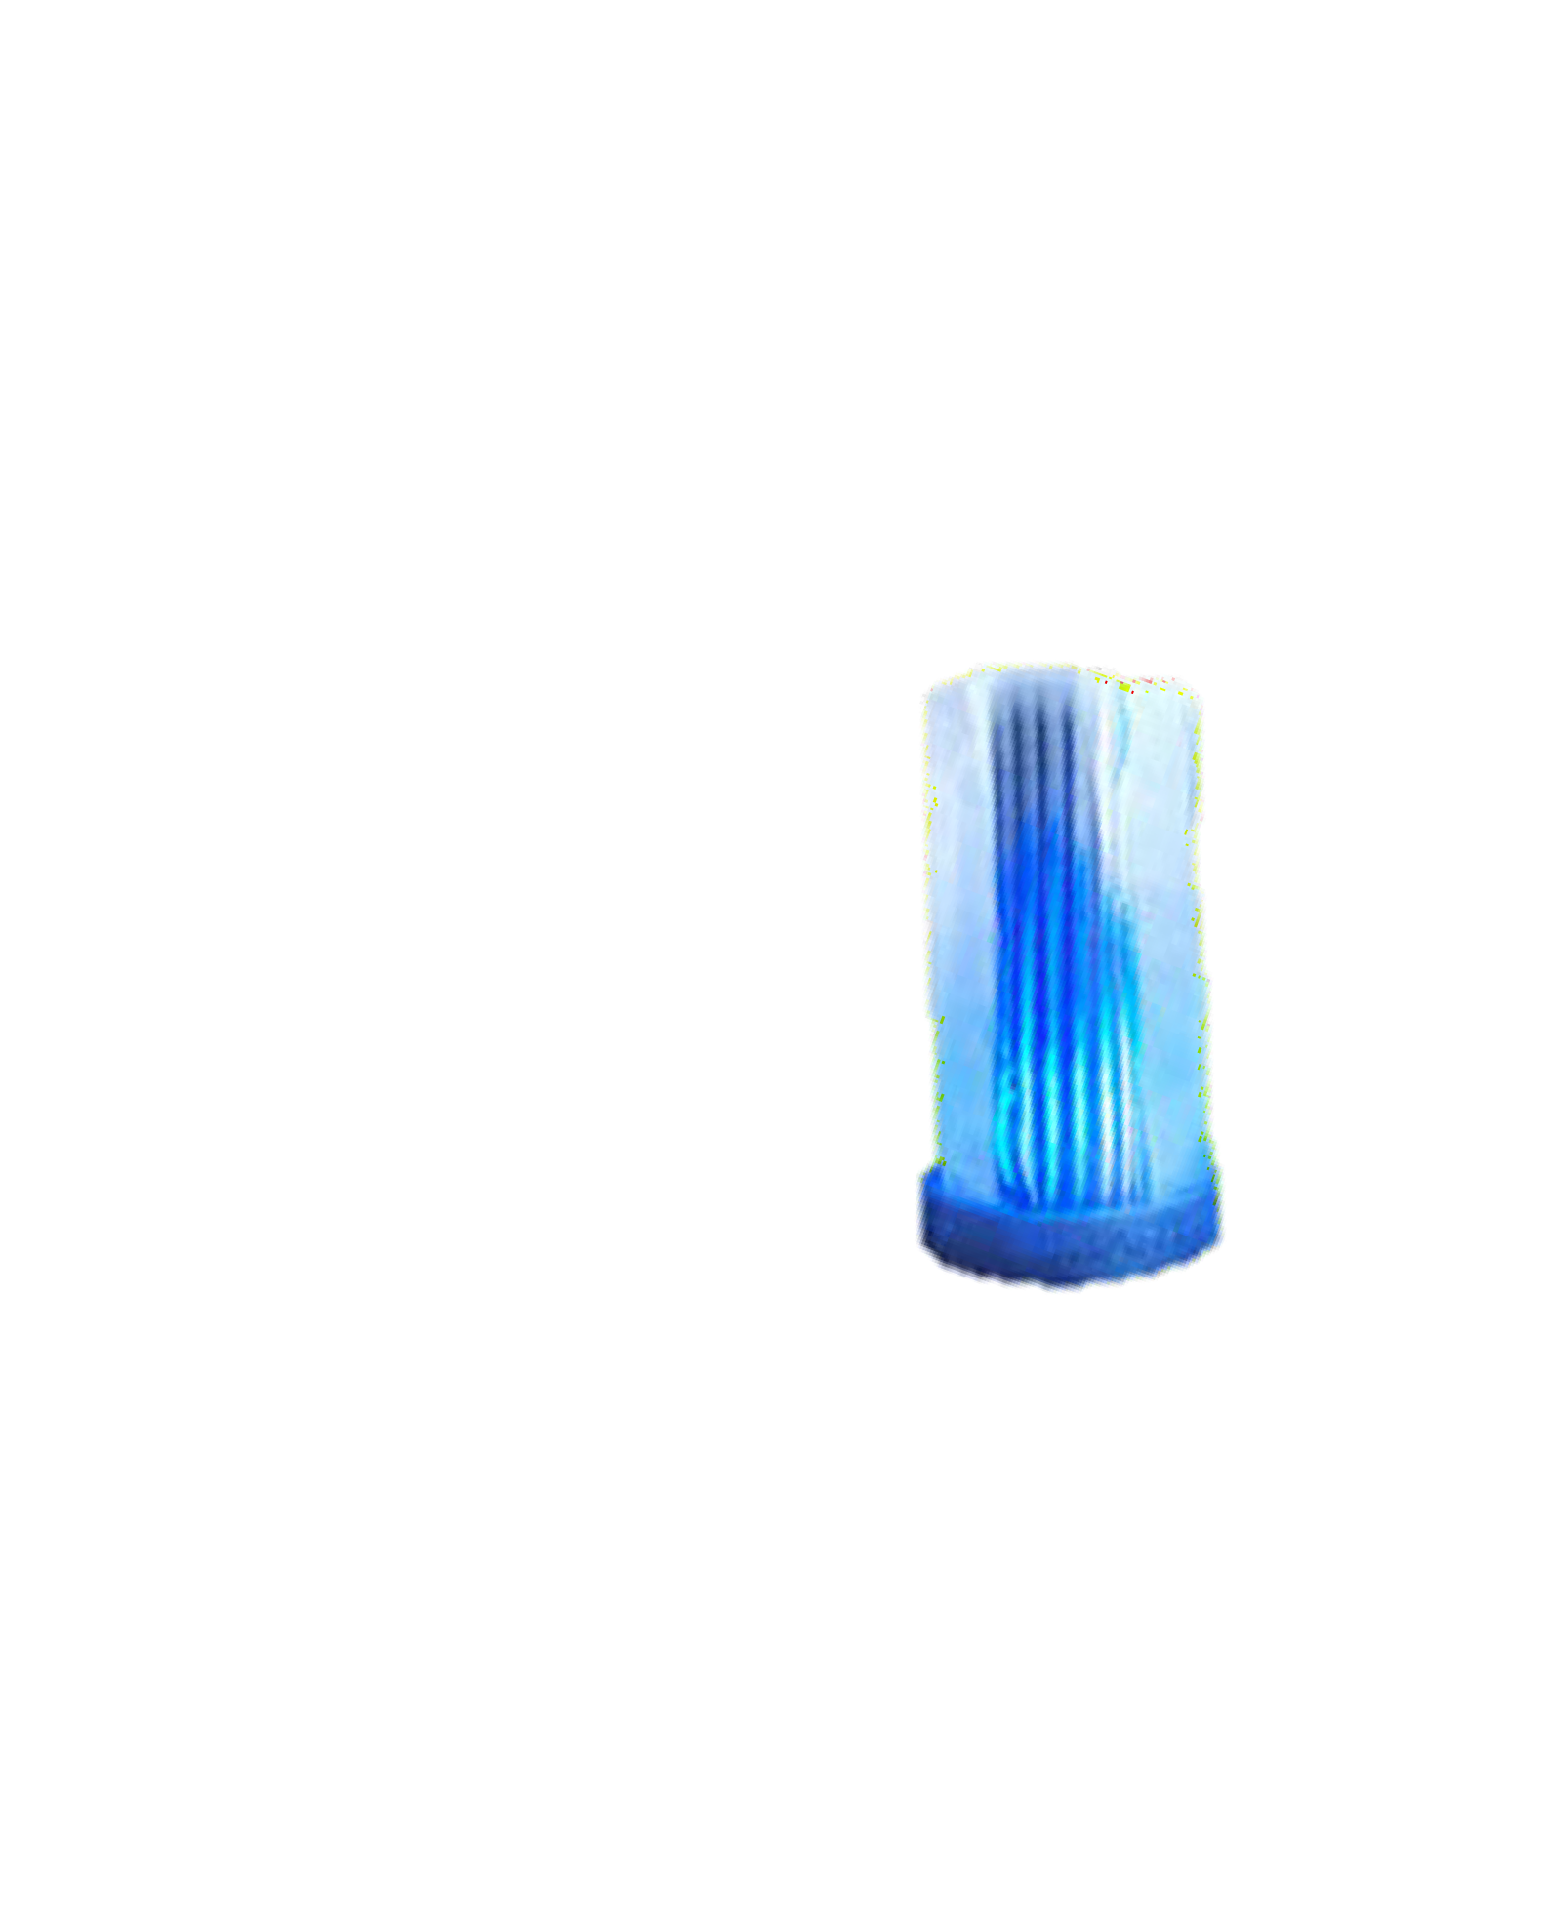







Slide 2


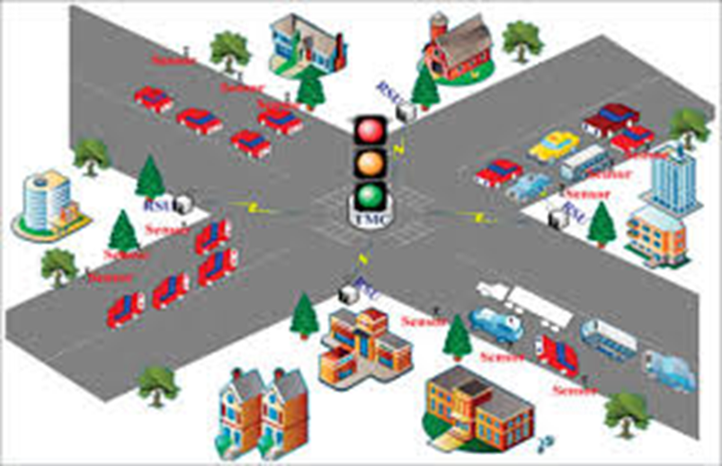
TRAFFIC MANAGEMNET SYSTEM

Slide 3
DESIGN THINKING
INTRODUCTION
LITERATURE SURVEY
WORKING
RESULTS
CONCLUSION & FUTURE WORK

Slide 4
INTRODUCTION
ONE OF THE MAJOR PROBLEMS FACED IN ANY METRO CITY IS TRAFFIC CONGESTION. HEAVY TRAFFIC IS A HEADACHE FOR EACH AND EVERY PERSON DRIVING THE VEHICLE AND EVEN TO THE TRAFFIC POLICE IN CONTROLLING THE TRAFFIC.
TRAFFIC CONGESTION HAS A NEGATIVE IMPACT ON ECONOMY, THE ENVIRONMENT AND THE OVERALL QUALITY OF LIFE.
THERE ARE TWO WAYS THROUGH WHICH TRAFFIC IS BEEN CONTROLLED
A) MANUALLY
B) SYSTEMATICALLY (CONTROLLERS)

Slide 5
One of the oldest ways of handling traffic was having a traffic policeman deployed at each
junction.
Traditional traffic light controllers: it uses a fixed predetermined schedule for traffic inflow for each direction.
However the whole idea of a fixed time traffic light controller is not convenient for cities where traffic flow is variable.
For this reason a dynamic traffic control system is needed, which controls the traffic signals
according to the density of traffic.
In our project we focus on optimization of traffic light using ir sensors and arduino uno as a microcontroller.
In our project our approach is to take data/input from ir sensors it will allow us to detect whether
the road is congested or not and will allow us to manage our traffic according to our input.

Slide 6
PROJECT DEFINITION
AN INTERNET OF THINGS (IOT)-ENABLED INTELLIGENT TRAFFIC MANAGEMENT SYSTEM CAN SOLVE PERTINENT ISSUES BY LEVERAGING TECHNOLOGIES LIKE WIRELESS CONNECTIVITY & INTELLIGENT SENSORS. CONSIDERED A CORNERSTONE OF A SMART CITY, THEY HELP IMPROVE THE COMFORT AND SAFETY OF DRIVERS, PASSENGERS & PEDESTRIANS.

Slide 7
PROJECT OBJECTIVE:
The main objective of the traffic management system is to monitoring system is to manage the details of vehicle types,routes,length,traffic polices,traffic.It manages all the information about vehicles types
,divertions,traffic,vehicle types.

Slide 8


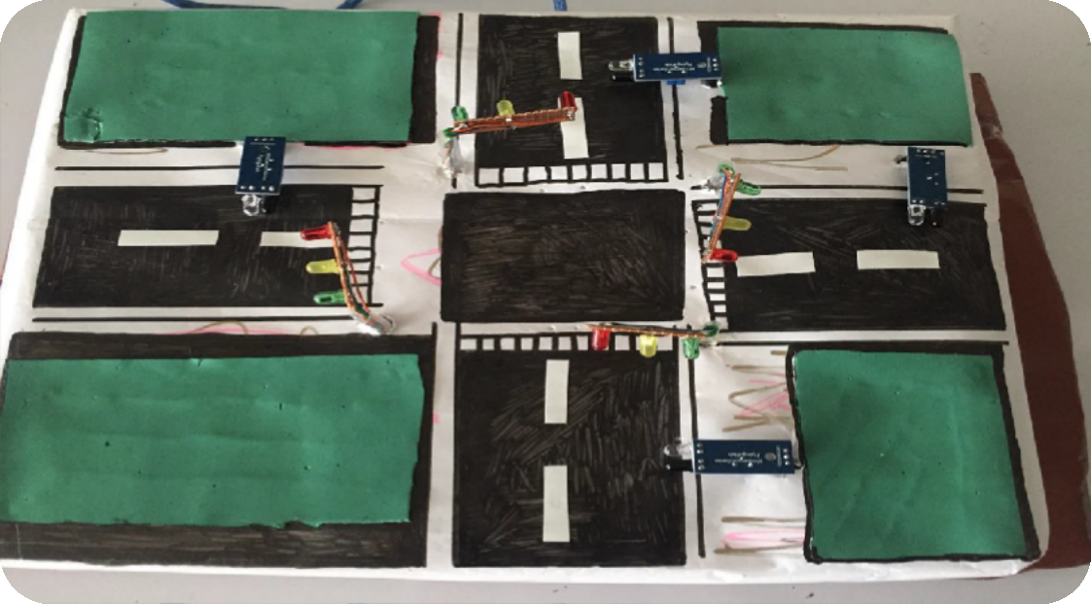
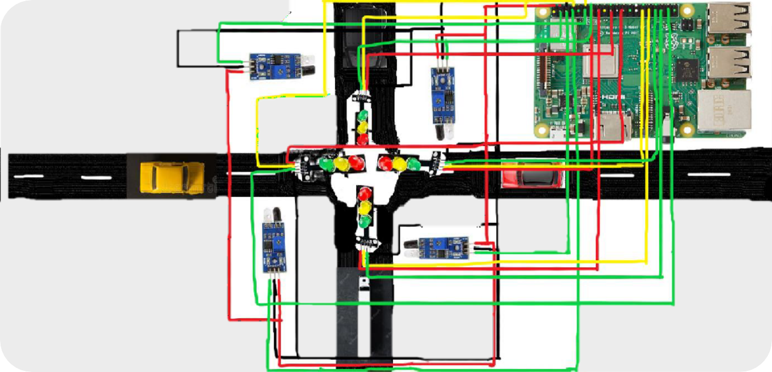
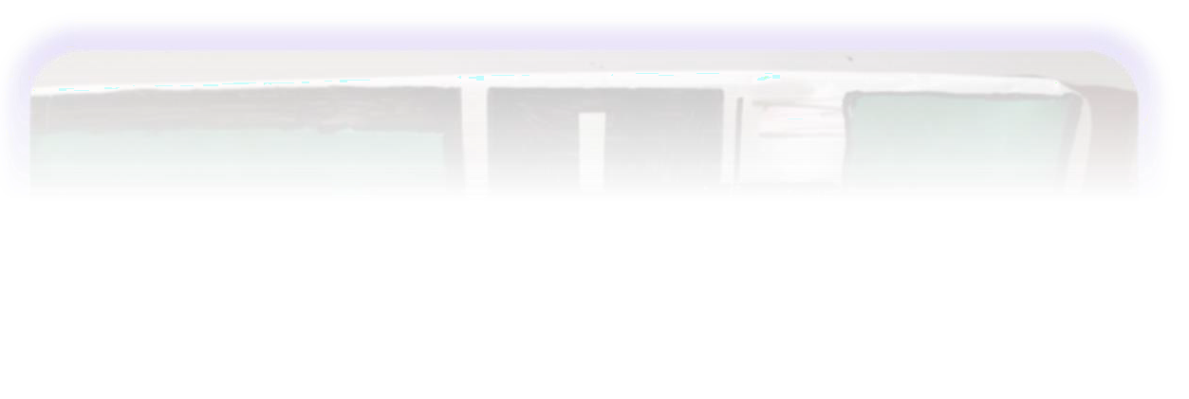
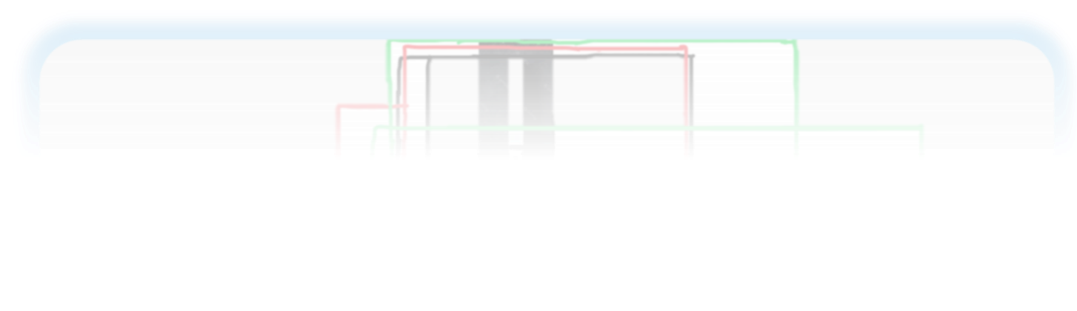
IOT SENSOR DESIGN

Slide 9

PLATFORM DEVELOPMENT:
CAMERA
RESISTORS
IR SENSOR
LED’S

Slide 10
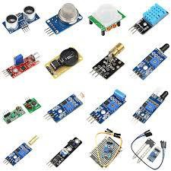
DESIGN THINKING:
IOT sensor device:
IOT sensors are used here, to detect the vehicles density among each road .This is used to reduce traffic in peak hours.
Mobile app:
It is used in this project to determine the traffic in each road .Using this app we can find easy way to go for destination.
Web design:
It is used in this project to determine the traffic in each way. Then it is used to select which way is free, then select that way and go through it to our destination.

Slide 11
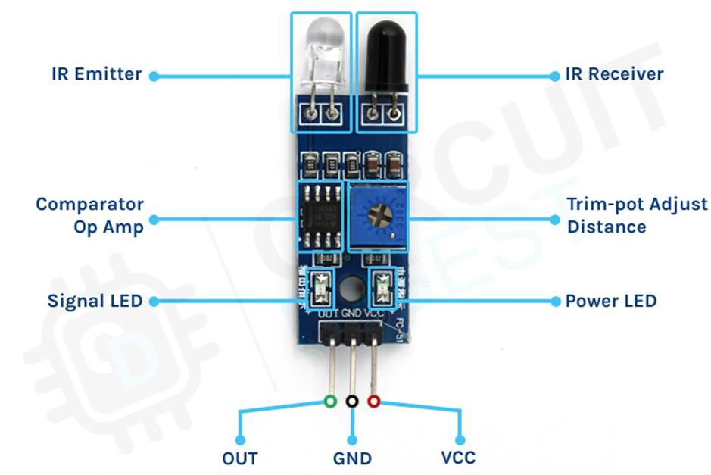
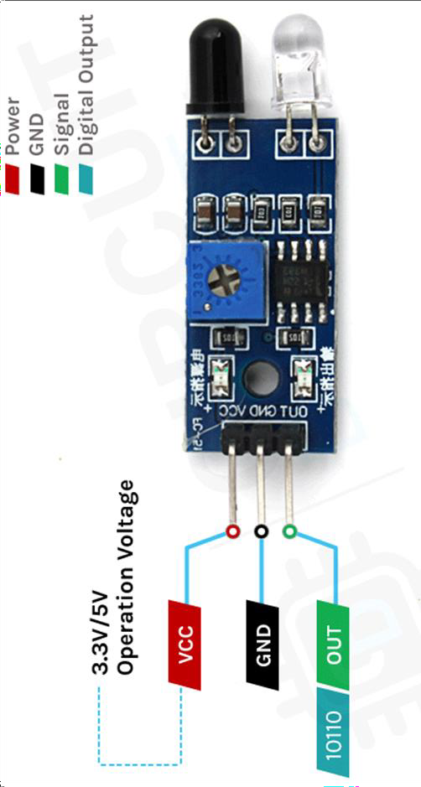
IR SENSORS:
IR sensor is an electronic device, that emits the light in order to sense some object of the surroundings. An IR sensor can measure the heat of an object as well as detects the motion. Usually, in the infrared spectrum, all the objects radiate some form of thermal radiation.

Slide 12
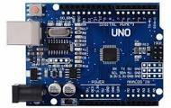
ARDUINO UNO
Arduino UNO is a microcontroller board based on the ATmega328P. It has 14 digital input/output pins (of which 6 can be used as PWM outputs), 6 analog inputs, a 16 MHz ceramic resonator, a USB connection, a power jack, an ICSP header and a reset button.

Slide 13
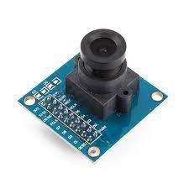
CAMERA
The OV7670 camera can be interfaced with an Arduino Uno microcontroller board to capture images and process them in real- time. The OV7670 camera module communicates with the Arduino Uno board via a parallel interface that requires eight data lines and several control signals.

Slide 14
PROGRAM 1:
#INCLUDE <IRREMOTE.H>
#DEFINE SIGNAL 11
INT R1=4 , G1=5 , Y1=12 , R2=6 , G2=7 ,Y2=13 , R3=8 , G3=9 ,Y3=10 , R4=2 , G4=3 ,Y4=A4 ;
VOID SETUP() {
// PUT YOUR SETUP CODE HERE, TO RUN ONCE:
SERIAL.BEGIN(9600); IRRECEIVER.BEGIN(SIGNAL); FOR(INT I=2 ; I<=9 ; I++){
PINMODE(I, OUTPUT);
}
}

Slide 15
VOID ALERT(INT CODE){
IF(CODE==48){ DIGITALWRITE(R1, LOW); DIGITALWRITE(G1, HIGH); DIGITALWRITE(Y1, LOW); DIGITALWRITE(R2, LOW); DIGITALWRITE(G2, LOW); DIGITALWRITE(Y2, HIGH);

Slide 16
Digitalwrite(r3, HIGH); digitalwrite(g3, LOW); digitalwrite(y3, LOW); digitalwrite(g1, LOW); digitalwrite(r4, HIGH); digitalwrite(g4, LOW); digitalwrite(y4, LOW); delay(3000);
}
Else if(code==24){ digitalwrite(r1, high); digitalwrite(g1, low); digitalwrite(y1, low); digitalwrite(r2, low); digitalwrite(g2, high); digitalwrite(y2, low); digitalwrite(r3, low); digitalwrite(g3, low); digitalwrite(y3, high); digitalwrite(r4, high); digitalwrite(g4, low); digitalwrite(y4, low); delay(3000);
}
Digitalwrite(r3, high); digitalwrite(g3, low); digitalwrite(y3, low); digitalwrite(r4, low); digitalwrite(g4, high); digitalwrite(y4, low); delay(3000);
}
}
Int code=0; void loop() {
// put your main code here, to run repeatedly: if(irreceiver.Decode()){
Irreceiver.Resume(); code=irreceiver.Decodedirdata.Command; alert(code);
}
Digitalwrite(r1, low); digitalwrite(g1, high); digitalwrite(y1, low); digitalwrite(r2, low); digitalwrite(g2, low);
Digitalwrite(r3, high);
Digitalwrite(g3, low);
Digitalwrite(y3, low);
Digitalwrite(g1, low);
Digitalwrite(r4, high);
Digitalwrite(g4, low);
Digitalwrite(y4, low);
Delay(3000);
}
Else if(code==24){
Digitalwrite(r1, high);
Digitalwrite(g1, low);
Digitalwrite(y1, low);
Digitalwrite(r2, low);
Digitalwrite(g2, high);
Digitalwrite(y2, low);
Digitalwrite(r3, low);
Digitalwrite(g3, low);
Digitalwrite(y3, high);
Digitalwrite(r4, high);
Digitalwrite(g4, low);
Digitalwrite(y4, low);
Delay(3000);
}

Slide 17
Digitalwrite(r3, HIGH);
digitalWrite(R4, HIGH); digitalWrite(G4, LOW); digitalWrite(Y4, LOW); delay(3000); if(IrReceiver.decode()){ IrReceiver.resume();
code=IrReceiver.decodedIRData.command;
Alert(code);
}
digitalWrite(R1, HIGH); digitalWrite(G1, LOW); digitalWrite(Y1, LOW); digitalWrite(R2, HIGH); digitalWrite(G2, LOW); digitalWrite(Y2, LOW); digitalWrite(R3, LOW); digitalWrite(G3, HIGH); digitalWrite(Y3, LOW); digitalWrite(R4, LOW); digitalWrite(G4, LOW); digitalWrite(Y4, HIGH); delay(3000); if(IrReceiver.decode()){
IrReceiver.resume(); code=IrReceiver.decodedIRData.command; Alert(code);
}
digitalWrite(R1, LOW); digitalWrite(G1, LOW); digitalWrite(Y1, HIGH); digitalWrite(R2, HIGH); digitalWrite(G2, LOW); digitalWrite(Y2, LOW); digitalWrite(R3, HIGH); digitalWrite(G3, LOW); digitalWrite(Y3, LOW); digitalWrite(R4, LOW); digitalWrite(G4, HIGH); digitalWrite(Y4, LOW); delay(3000);
}
Digitalwrite(g3, LOW);
Digitalwrite(y3, LOW);
Digitalwrite(r4, LOW);
Digitalwrite(g4, HIGH);
Digitalwrite(y4, LOW);
Delay(3000);
}
}
Int code=0;
Void loop() {
// put your main code here, to run repeatedly:
If(irreceiver.Decode()){
Irreceiver.Resume();
Code=irreceiver.Decodedirdata.Command;
alert(code);
}
Digitalwrite(r1, low);
Digitalwrite(g1, HIGH);
Digitalwrite(y1, LOW);
Digitalwrite(r2, LOW);
Digitalwrite(g2, LOW);

Slide 18
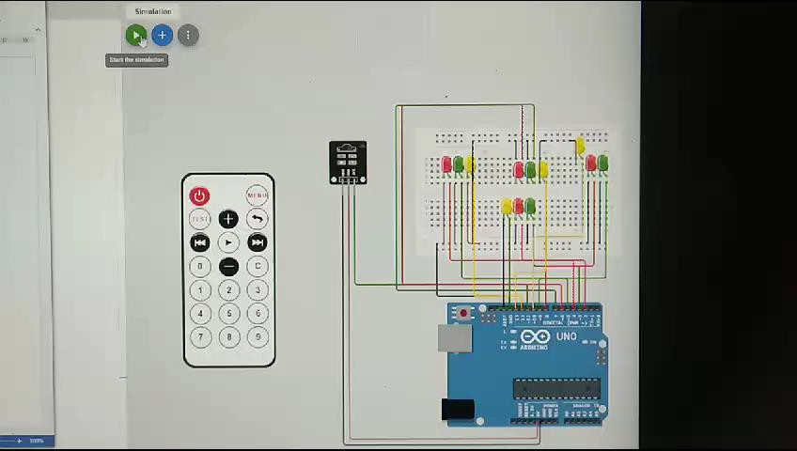
JUST SAMPLE PROGRAM USING ONLY LED’S

Slide 19
PROGRAM 2:
COMPONENTS:
ARDUINO UNO
4 LED’S
2 PUSHBUTTON
WIRES

Slide 20
Void loop() {
const int mainRoadRedPin = 2; const int mainRoadGreenPin = 3; const int sideRoadRedPin = 4; const int sideRoadGreenPin = 5; const int mainRoadSensorPin = 6; const int sideRoadSensorPin = 7; void setup() {
pinMode(mainRoadRedPin, OUTPUT); pinMode(mainRoadGreenPin, OUTPUT); pinMode(sideRoadRedPin, OUTPUT); pinMode(sideRoadGreenPin, OUTPUT); pinMode(mainRoadSensorPin, INPUT_PULLUP);
pinMode(sideRoadSensorPin, INPUT_PULLUP);
}
} else if (digitalRead(sideRoadSensorPin)
== LOW) {
// Side road has vehicles, so stop main road traffic
digitalWrite(mainRoadRedPin, HIGH); digitalWrite(mainRoadGreenPin, LOW); digitalWrite(sideRoadRedPin, LOW); digitalWrite(sideRoadGreenPin, HIGH);
} else {
// No vehicles, all lights are red (4-way stop)
digitalWrite(mainRoadRedPin, LOW);
digitalWrite(mainRoadGreenPin, HIGH);
digitalWrite(sideRoadRedPin, LOW); digitalWrite(sideRoadGreenPin, HIGH);
}
}
// check if there are vehicles on the main road
If (digitalread(mainroadsensorpin)
== LOW) {
// main road has vehicles, so stop side road traffic
Digitalwrite(mainroadredpin, LOW);
Digitalwrite(mainroadgreenpin, HIGH);
Digitalwrite(sideroadredpin, HIGH); Digitalwrite(sideroadgreenpin,
LOW);

Slide 21
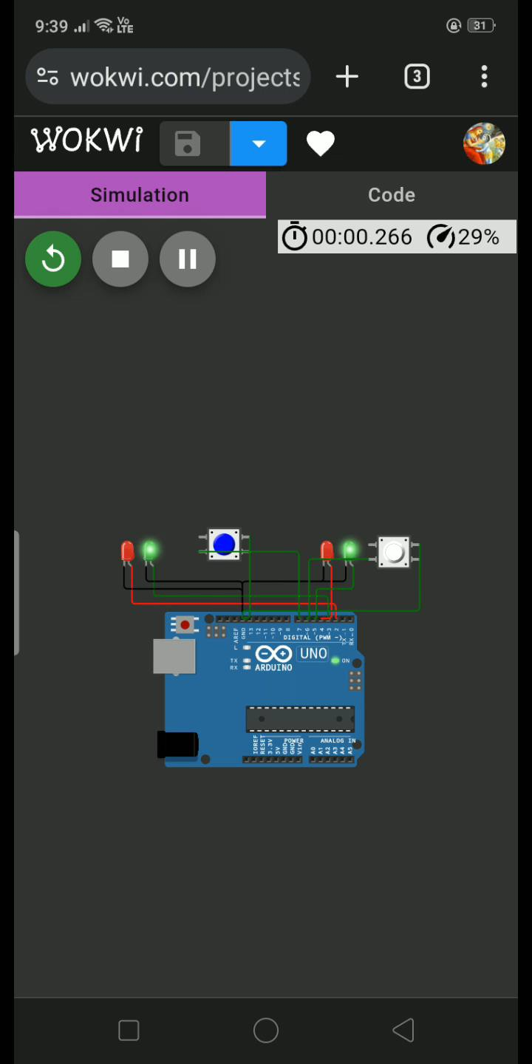
OUTPUT(VIDEO):
This output used only in two roads.
WOKWI project link:
https://wokwi.com/projects/379571034449458177

Slide 22
PROGRAM 3:
COMPONENTS:
ARDUINO UNO
4 LED’S
2 PUSHBUTTON
WIRES

Slide 23
CODING
CONST INT MAINROADREDPIN = 2;
void setup() { pinMode(mainRoadRedPin, OUTPUT);
pinMode(mainRoadGreenPin, OUTPUT); pinMode(mainRoadYellowPin, OUTPUT); pinMode(leftRoadRedPin, OUTPUT); pinMode(leftRoadGreenPin, OUTPUT); pinMode(leftRoadYellowPin, OUTPUT); pinMode(rightRoadRedPin, OUTPUT); pinMode(rightRoadGreenPin, OUTPUT); pinMode(rightRoadYellowPin, OUTPUT); pinMode(mainRoadSensorPin, INPUT_PULLUP); pinMode(leftRoadSensorPin, INPUT_PULLUP); pinMode(rightRoadSensorPin, INPUT_PULLUP);
}
void loop() {
// Check if there are vehicles on the main road
if (digitalRead(mainRoadSensorPin) == HIGH) {
// Main road has vehicles, so stop side road traffic digitalWrite(mainRoadRedPin, HIGH); digitalWrite(mainRoadGreenPin,LOW); digitalWrite(mainRoadYellowPin, LOW); digitalWrite(leftRoadRedPin, LOW); digitalWrite(leftRoadGreenPin,LOW); digitalWrite(leftRoadYellowPin, HIGH); digitalWrite(rightRoadRedPin, LOW); digitalWrite(rightRoadGreenPin, HIGH); digitalWrite(rightRoadYellowPin, LOW);
}
else if (digitalRead(leftRoadSensorPin) ==HIGH) {
// left road has vehicles, so stop main road traffic digitalWrite(mainRoadRedPin, HIGH); digitalWrite(mainRoadGreenPin, LOW); digitalWrite(mainRoadYellowPin, LOW); digitalWrite(leftRoadRedPin, LOW); digitalWrite(leftRoadGreenPin,HIGH); digitalWrite(leftRoadYellowPin, LOW); digitalWrite(rightRoadRedPin, LOW); digitalWrite(rightRoadGreenPin, LOW); digitalWrite(rightRoadYellowPin, HIGH);
}
CONST INT MAINROADGREENPIN = 3;
else if (digitalRead(rightRoadSensorPin) == HIGH) {
// right road has vehicles, so stop main road traffic digitalWrite(mainRoadRedPin, LOW); digitalWrite(mainRoadGreenPin, LOW); digitalWrite(mainRoadYellowPin, HIGH); digitalWrite(leftRoadRedPin,HIGH); digitalWrite(leftRoadGreenPin, LOW); digitalWrite(leftRoadYellowPin, LOW); digitalWrite(rightRoadRedPin, LOW); digitalWrite(rightRoadGreenPin, HIGH); digitalWrite(rightRoadYellowPin, LOW);
}
CONST INT MAINROADYELLOWPIN=11;
CONST INT LEFTROADREDPIN = 4;
CONST INT LEFTROADGREENPIN = 5;
CONST INT LEFTROADYELLOWPIN=8;
CONST INT RIGHTROADREDPIN = 10;
CONST INT RIGHTROADGREENPIN = 6;
CONST INT RIGHTROADYELLOWPIN =9;
else {
// No vehicles, all lights are red (4-way stop) digitalWrite(mainRoadRedPin, LOW); digitalWrite(mainRoadGreenPin, HIGH); digitalWrite(mainRoadYellowPin, LOW); digitalWrite(leftRoadRedPin, LOW); digitalWrite(leftRoadGreenPin, HIGH); digitalWrite(leftRoadYellowPin, LOW); digitalWrite(rightRoadRedPin, LOW); digitalWrite(rightRoadGreenPin, HIGH); digitalWrite(rightRoadYellowPin, LOW);
}
}
CONST INT MAINROADSENSORPIN = 7;
CONST INT LEFTROADSENSORPIN =13;
CONST INT RIGHTROADSENSORPIN =12;
}

Slide 24
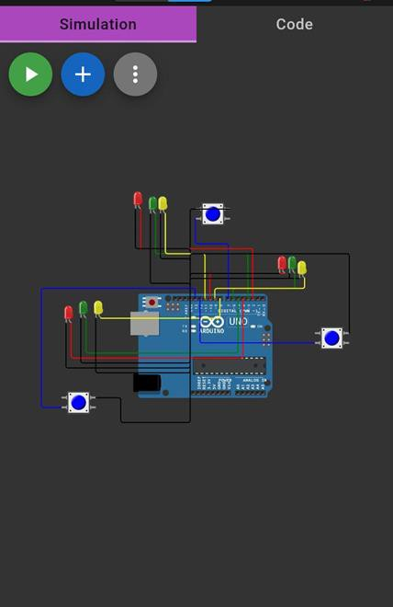
OUTPUT(IMAGE):
This is the output for 3 roads
WOKWI PROJRCT 2 LINK:
https://wokwi.com/projects/379571034449458177

Slide 25
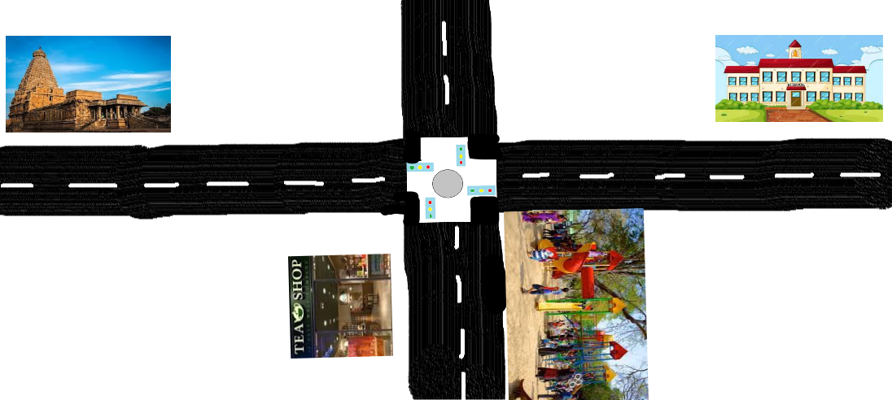
CHART definition :
Using chart we have to analyze the traffic flow in this given road,
FIRST ROAD:
In first road it has temple it will busy on evening time (4:00 pm to 7:00 pm)(6:00 am to 9:00am)
SECOND ROAD:
In this road it has tea shop it has peak in morning and evening(6:00 am to 9:00 am)and (6:00 pm to 9:00pm).
THIRD ROAD:
In this road it has school which is busy in morning and evening(8:00am to 9:30am) and (4:00pm to 6:00pm).
FOURTH ROAD:
Here it has a children’s park it is busy in evening time and morning for Walking for adults.(5:00 pm to 7:00 pm).
4
1
3
2

Slide 26
CHART FOR ABOVE 4 WAY:

Slide 27
APPLICATION
Traffic lights and IOT control systems
Parking enabled through IOT
Commute assistance

Slide 28
DISADVANTAGE:
EXPENSIVE IF DRAINAGE WORKS ARE NECESSARY .
LOSS OFON STREET PARKING
LIMITED SPEED REDUCING EFFECT

Slide 29
CONCLUSION:
These signs prevent congestion and ensure that cehicles are parked in designated areas .Finally
,traffic signs provide information about maintaining the desired speed limit whilwe crossing any
institutes to prevent accidents

Slide 30
































Thank you…
By:
L.R.Sowmidra
S.Anandhi
R.Umadevi
A.Srinithi
A.Santhiya
S.Santhanalakshmi
College name: University College Of Engineering, Panruti.

